Slide 1
Abstract
Abstract
Introduction
Existing System
Proposed System
Software requirements
Architecture Model
Modules
UML Diagrams/ER Diagrams/Flow Charts
References
Motorcycles have always been the primary mode of transport in developing countries. In recent years, there has been a speedy increase in motorcycle accidents owing to the fact that majority of the motor bicyclist fail to wear helmet that makes it an ever-present danger.
Here, to detect the motorcyclists who are violating the helmet laws, a system using Deep Learning and convolutional neural network is implemented where license plate of the motorcycle is detected using OCR if rider fails to wear helmet.

Slide 2
Abstract
Introduction
Existing System
Proposed System
Software requirements
Architecture Model
Modules
UML Diagrams/ER Diagrams/Flow Charts
References
Abstract
Introduction
Existing System
Proposed System
Software requirements
Architecture Model
Modules
UML Diagrams/ER Diagrams/Flow Charts
References
Abstract
Introduction
Existing System
Proposed System
Software requirements
Architecture Model
Modules
UML Diagrams/ER Diagrams/Flow Charts
References
Introduction
All over the world around 1.35 million lives are lost each year, 50 million people are getting injured due to road accidents, according to a report titled “The Global status report on road safety 2018” released by WHO.
Helmet reduces the chances of skull getting decelerated, hence sets the motion of the head to almost zero.
Manual surveillance of traffic using CCTV is an existing methodology.

Slide 3
Introduction
Existing System
Proposed System
Software requirements
References
Abstract
Introduction
Existing System
Proposed System
Software requirements
Architecture Model
Modules
UML Diagrams/ER Diagrams/Flow Charts
References
Existing System
The Existing system monitors the traffic violations primarily through CCTV recordings, where the traffic police have to look into the frame where the traffic violation is happening, zoom into the license plate in case rider is not wearing helmet.
Research was done on CNN, R-CNN, LBP, HoG, HaaR features,etc. But these works are limited with respect to efficiency, accuracy or the speed of detecting.

Slide 4
Introduction
Existing System
Proposed System
Software requirements
References
Abstract
Introduction
Existing System
Literature Review
Methodology
Proposed System
Software requirements
Architecture Model
Modules
UML Diagrams/ER Diagrams/Flow Charts
References
Literature Review
Circle arc detection method based on Hough transform. They applied it to detect the presence of helmet which failed to give accurate result.
Combination of image processing and (OCR) Optical Character Recognition to detect vehicle number plate under different background but it has worked on static i.e. non - moving images in Malaysia.

Slide 5
Introduction
Existing System
Proposed System
Software requirements
References
Abstract
Introduction
Existing System
Literature Review
Methodology
Proposed System
Software requirements
Architecture Model
Modules
UML Diagrams/ER Diagrams/Flow Charts
References
Methodology
The objects detected are person, motorcycle/moped at first level using YOLOv2, helmet at second level using YOLOv3, License plate at the last level using YOLOv2.
Then the license plate registration number is extracted using OCR (Optical Character Recognition)

Slide 6
Introduction
Existing System
Proposed System
Software requirements
References
Abstract
Introduction
Existing System
Proposed System
Software requirements
Architecture Model
Modules
UML Diagrams/ER Diagrams/Flow Charts
References
Abstract
Introduction
Existing System
Literature Review
Methodology
Proposed System
Software requirements
Architecture Model
Modules
UML Diagrams/ER Diagrams/Flow Charts
References
Proposed System
Object detection principle with YOLO architecture is used for motorcycle, person, helmet and license plate detection.
YOLOv2 and COCO dataset can be employed to detect different types of objects and classify them accordingly.
The proposed system for feature extraction uses LBP based hybrid descriptor, HOG and Hough transform descriptors.
2/10

Slide 7
Introduction
Existing System
Proposed System
Software Requirements
References
Abstract
Introduction
Existing System
Proposed System
Software requirements
Architecture Model
Modules
UML Diagrams/ER Diagrams/Flow Charts
References
Abstract
Introduction
Existing System
Literature Review
Methodology
Proposed System
Software requirements
Architecture Model
Modules
UML Diagrams/ER Diagrams/Flow Charts
References
Software Requirements
Operating Environment :Anaconda, Spyder
Operating System : Windows 10,LINUX
Programming Language : Python
Technology : Deep Learning
Models : OCR,YOLO,CNN
2/10

Slide 8
Architecture Model
Abstract
Introduction
Existing System
Proposed System
Software requirements
Architecture Model
Modules
UML Diagrams/ER Diagrams/Flow Charts
References
Abstract
Introduction
Existing System
Literature Review
Methodology
Proposed System
Software requirements
Architecture Model
Modules
UML Diagrams/ER Diagrams/Flow Charts
References
Architecture Model
Input Video
Preprocessing and Background removal
Segmentation of Two wheelers
Detection of Motorcyclists without Helmet
Extract and display License plate number from image

Slide 9
Modules
Abstract
Introduction
Existing System
Proposed System
Software requirements
Architecture Model
Modules
UML Diagrams/ER Diagrams/Flow Charts
References
Motorcycle Detection : The motorcycles are detected using feature like HOG detector.
Helmet Classification : After that the obtained images of head and helmet is fed to a convolutional neural network (CNN) thereby classifying helmet and non-helmet motorcyclist.
Detection of License plate and Character classification using OCR.

Slide 10
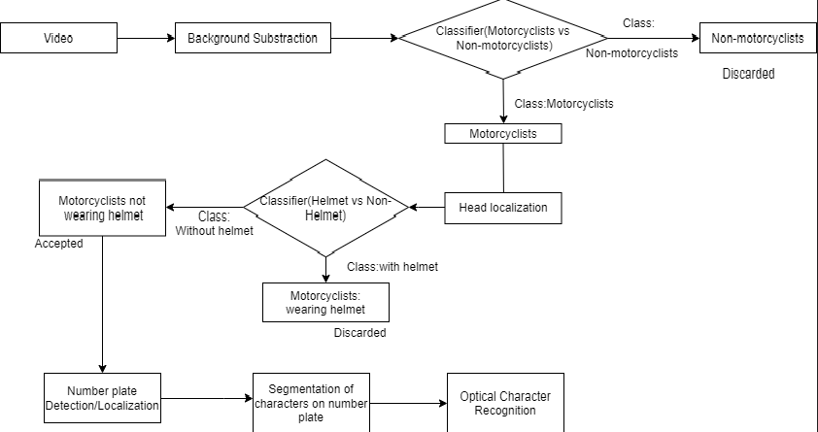
UML Diagrams/ER Diagrams/Flow Charts
Abstract
Introduction
Existing System
Proposed System
Software requirements
Architecture Model
Modules
UML Diagrams/ER Diagrams/Flow Charts
References
Flow Chart

Slide 11
d
UML Diagrams/ER Diagrams/Flow Charts
Abstract
Introduction
Existing System
Proposed System
Software requirements
Architecture Model
Modules
UML Diagrams/ER Diagrams/Flow Charts
References
USE CASE DIAGRAM

Slide 15
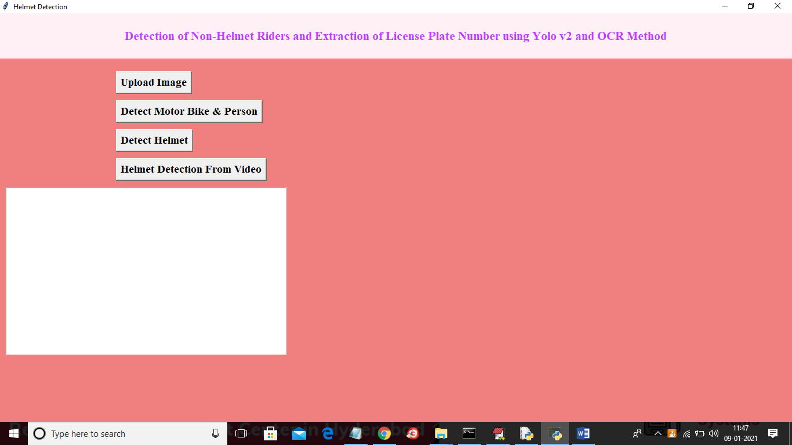

Slide 16
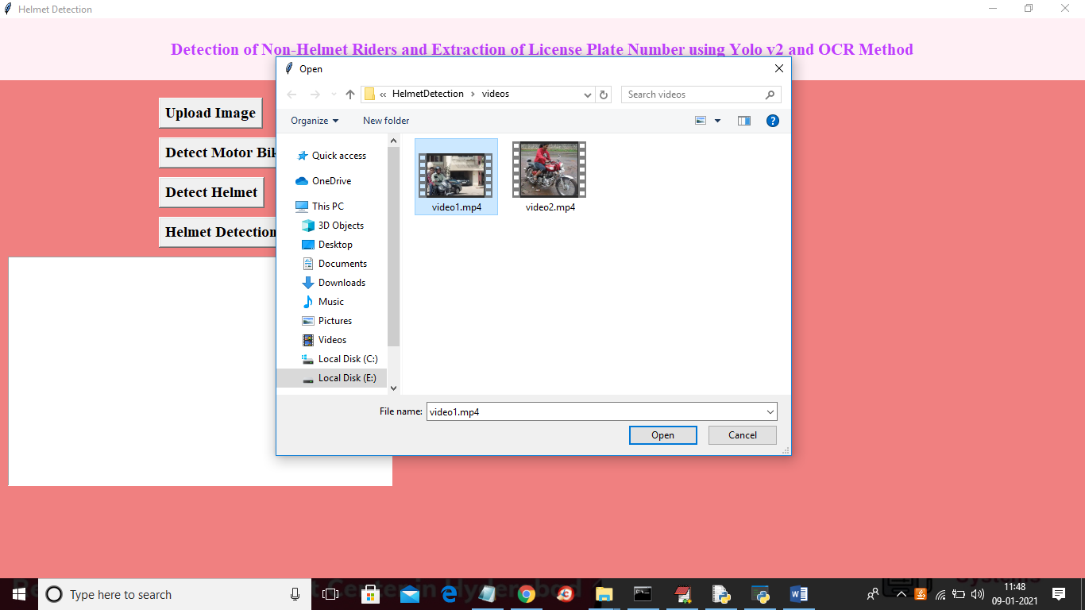

Slide 17
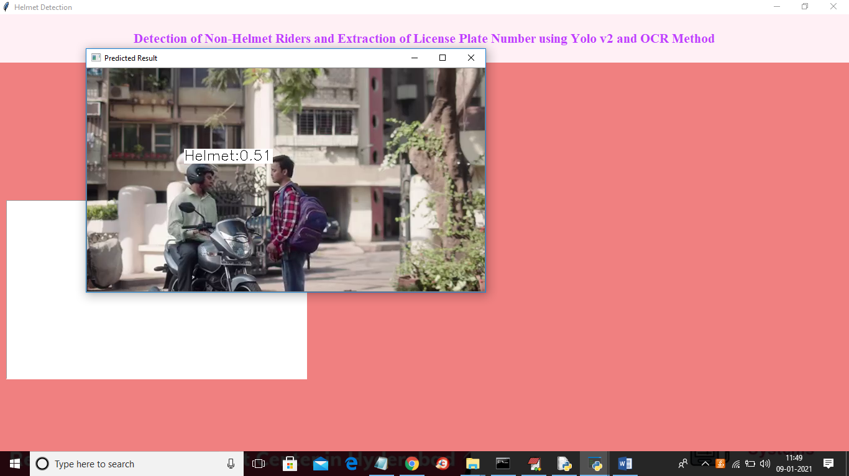

Slide 18
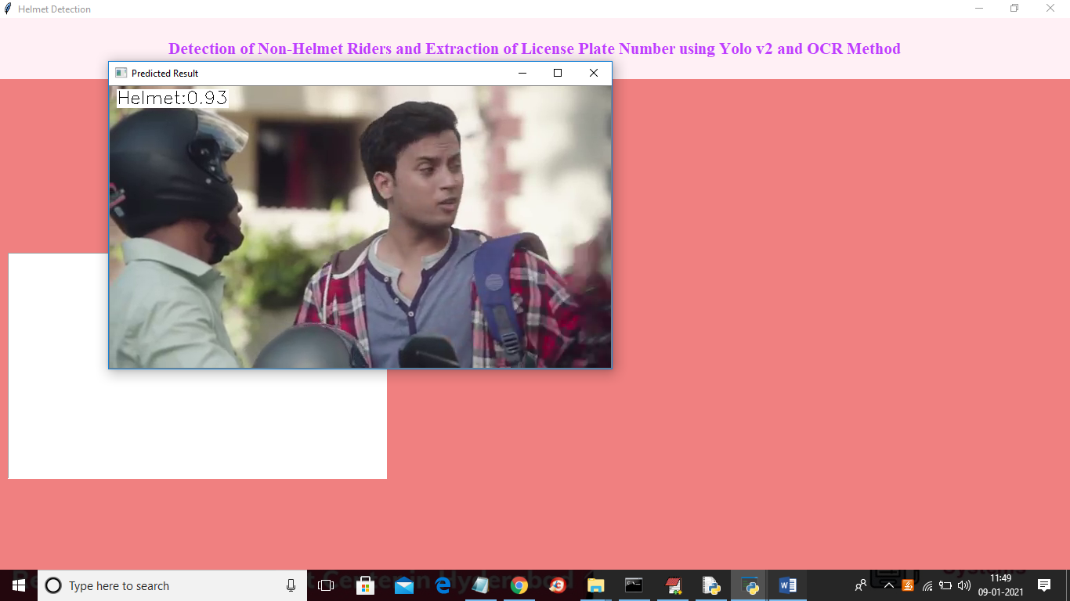

Slide 19
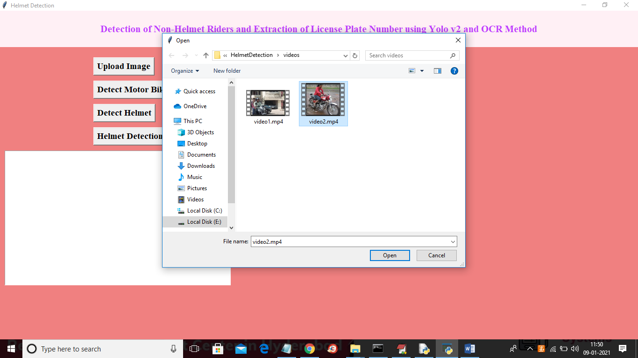

Slide 20
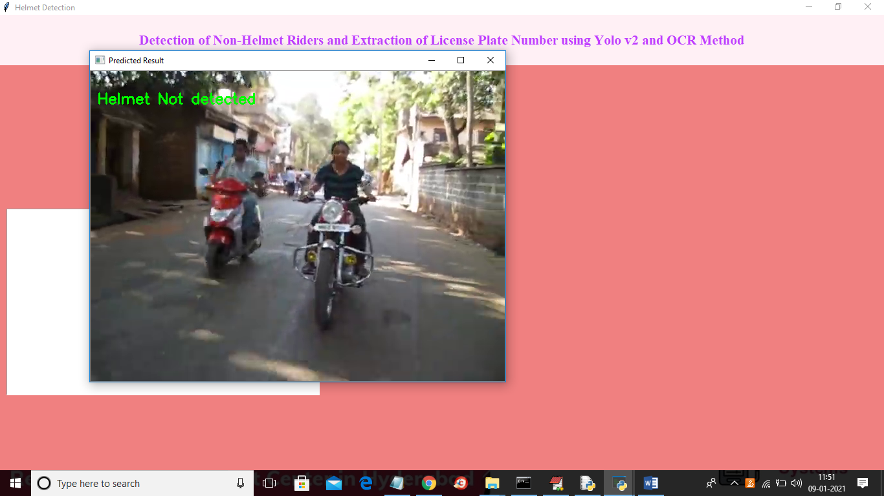

Slide 21
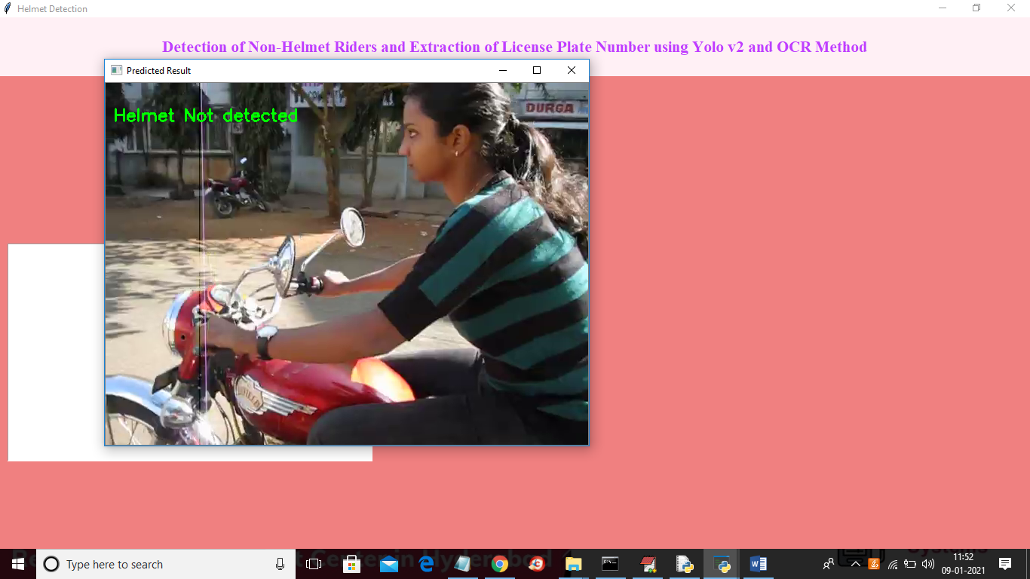

Slide 22
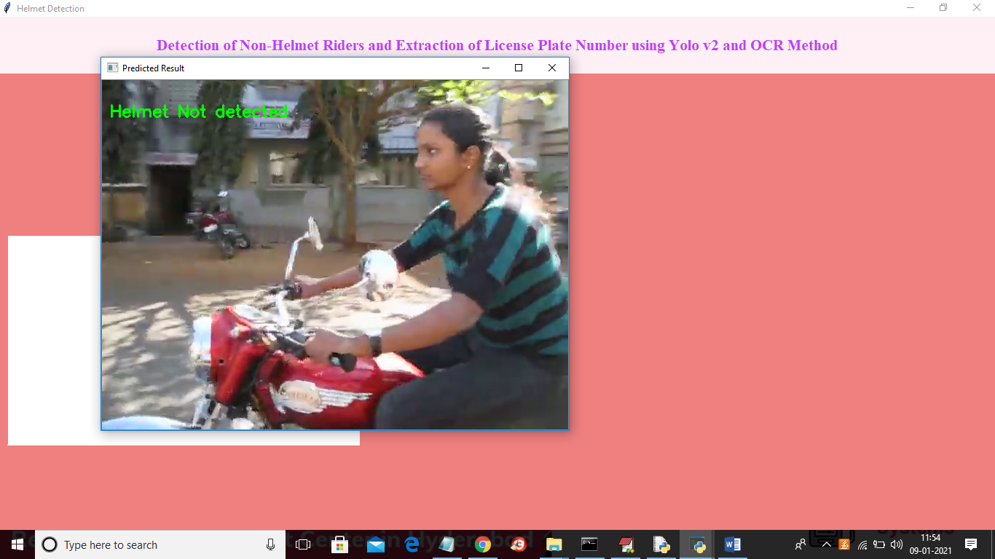

Slide 23
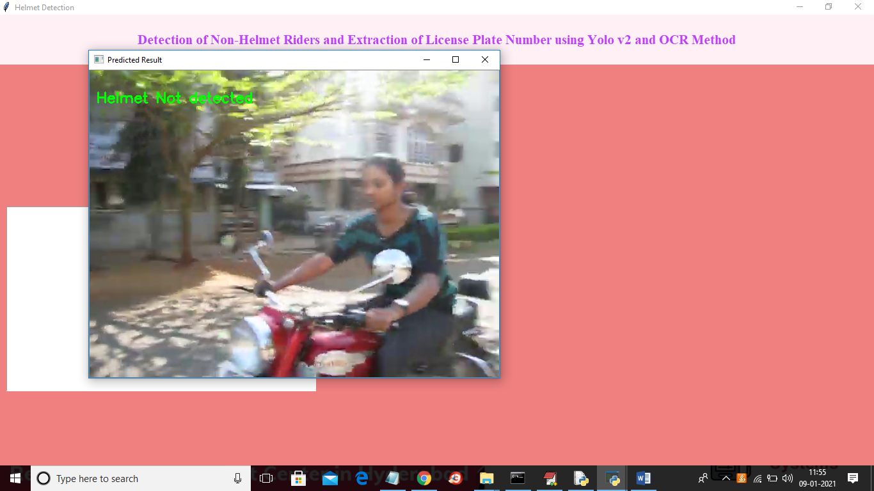

Slide 24
Conclusion
A Non-Helmet Rider Detection system is developed where a video file is taken as input. If the motorcycle rider in the video footage is not wearing helmet while riding the motorcycle, and then here we are uploading image to identify license plate number of that motorcycle is extracted from image and displayed. Object detection principle with YOLO architecture is used for motorcycle, person, helmet and license plate detection. OCR is used for license plate number extraction if rider is not wearing helmet. Not only the characters are extracted, but also the frame from which it is also extracted so that it can be used for other purposes. All the objectives of the project is achieved satisfactorily.

Slide 25
Introduction
Existing System
Proposed System
Software requirements
References
Abstract
Introduction
Existing System
Proposed System
Software requirements
Architecture Model
Modules
UML Diagrams/ER Diagrams/Flow Charts
References
References
K. Dahiya, D. Singh and C.K .Mohan, "Automatic detection of bike riders without helmet using surveillance videos in real - time", in Proceeding of International Joint Conference Neural Networks (IJCNN), pp.3046-3051, Vancouver, Canada , 24-2 July 2016.
Rahim Panahi, “Accurate Detection and Recognition of Dirty Vehicle Plate Numbers for High- Speed Applications", IEEE transactions on intelligent transportation systems, pg.767-779,vol. 18, no. 4, April 2017.
J.Chiverton, “Helmet Presence Classification with Motorcycle Detection And Tracking”, IET Intelligent Transport Systems, pp. 259–269 ,Vol. 6, Issue 3, March 2012.
Thepnimit Marayatr, Pinit Kumhom, “Motorcyclist‟s Helmet Wearing Detection Using Image Processing”, Advanced Materials Research,pp.588-592, Vol 931- 932,May-2014.
2/1

Slide 26
Q and A?
?

